Slide 1

Learn to Listen, Listen to Learn
Notes:
Prompt the participants to think back to the earlier session on Day One, “Know Thyself.” Ask
open-ended questions to get them to think about how they listen and encourage them to
begin opening up about what they perceive as their strengths and weaknesses.
● Ask: “When you think about your skills, your strengths, and your tendencies, how
many of you would say that one of your strengths is being a good listener?” Rate
yourself on a scale of 1 to 10, with 10 being “best.”
● Ask: “When you think about how other people perceive you, how do you think
they’d rate you as a good listener, on the worst/best scale of 1 to 10?”
● Ask: “What do you think it means to be a good listener?”
(Note: Explain that listening is an important skill of leadership, and this session will explore the
answer to the last question in detail.)

Slide 2

Objectives
Explain how we listen.
Examine barriers to effective listening and how they affect communication.
Apply effective listening skills.
Evaluate a feedback scenario.

Slide 3

Learning Tool
Notes:
“The tool for this session is a stethoscope. If you’re a medical caregiver, you know that to be
able to help your patient, you need to listen to what they’re saying, and you also need to
pay attention to other signals from their body. The stethoscope is a tool to amplify those
signals so you can hear them, but it requires concentration and a conscious effort to
listen carefully—the same way a good leader must listen carefully to the people around
them. Like a stethoscope, the skill of effective listening helps you use the power of
perception not only to hear the words from someone’s mouth but also to understand
what’s in their heart.”

Slide 4
Role-play
Speaker/Listener
Notes:
This brief role-play involves a short conversation where participants are instructed to use
ineffective listening techniques. While the instructions are admittedly simplistic, and the
acting is likely to be exaggerated, the goal of this role-play and the ensuing discussion is
to lighten the mood, open participants’ minds, and get them to start thinking about how
the way people listen (or don’t listen) affects other people and the outcome of a
conversation. The role-play itself should only take 2 minutes.
Directions
1. Pair off the participants. Appoint a speaker and a listener in each pair. If there is an
odd number of participants, the troop guide can join as a speaker.
2. Give each of the listeners one instruction card. The listener will keep the card’s
message hidden from the speaker. Instruct the speakers to talk to the listeners for
one minute about a recent trip or vacation or a favorite hobby or pastime.
3. Each listener responds with behavior determined by the assigned message:
o Interrupt the speaker.
o Give the speaker advice before they are done speaking.
o Give the speaker a blank look.
o Be bored.
After the role-play, take a few minutes for an open discussion with the patrol as a whole.
● Ask the speakers what they just experienced. How did the reactions of the listeners
affect them?
● Ask the listeners how the speakers responded to their particular listening behavior.
Listening as a Key Leadership Skill

Slide 5
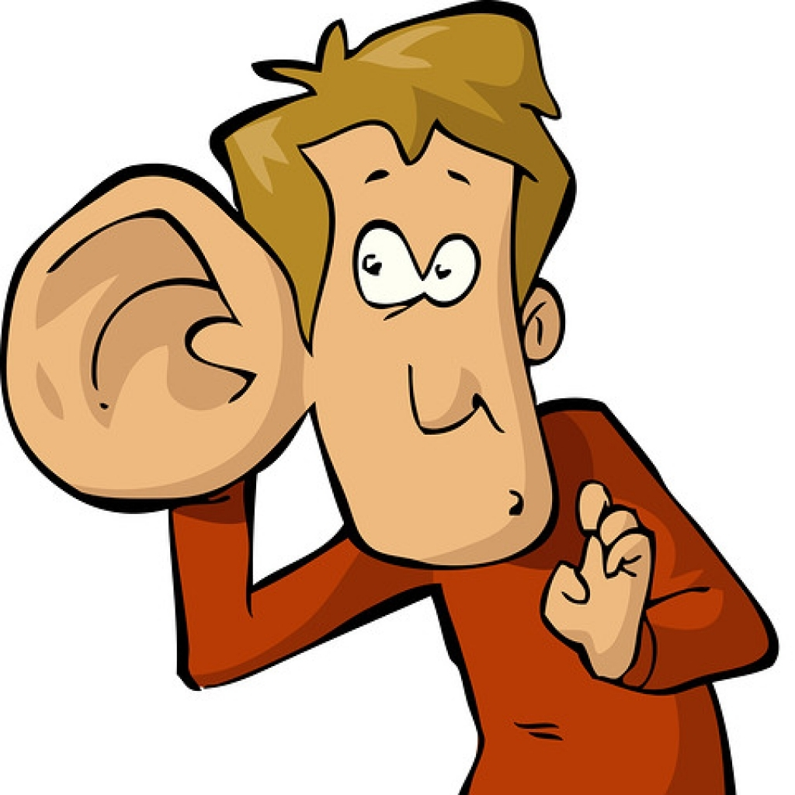
Key Leadership Skill
LISTENING:
Is an important leadership skill.
Helps two-way communication.
Helps us work together to make decisions and find solutions.
Working with youth…
Notes:
Explain that listening is a critical part of effective two-way communication, which we talked
about in the last session about communicating effectively. Listening is how we make
sure that the receiver gets the message.
Listening is an important leadership skill because it helps us learn and connect with people.
Sharing ideas and experiences with one another creates trust, understanding, and an
awareness of one another’s strengths and skills. These are the building blocks of
friendships and teamwork.
Listening helps us work together to make decisions and find solutions. It’s hard to move a
conversation forward and make progress if you’re not really listening.
Note how many of the participants in the patrol work directly with youth, and emphasize how
important it is to listen to them. Young people may not be accustomed to adults truly
listening to them. When you listen with care and understanding, it can be a meaningful
experience for them and for you.

Slide 6
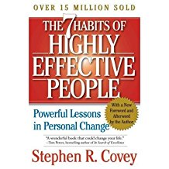
One of the 7 Habits
“Seek first to understand,
then to be understood.”
—Stephen R. Covey,
The 7 Habits of Highly Effective People
Notes:
Share quote:
To understand, we need to listen. And effective listening is more than just hearing what
somebody else is saying. That’s what this session is all about: raising awareness of the
importance of listening and how we do it.
Two Parts of Effective Listening
Explain the two parts of effective listening with key words written on a whiteboard or flip chart for
reinforcement.

Slide 7
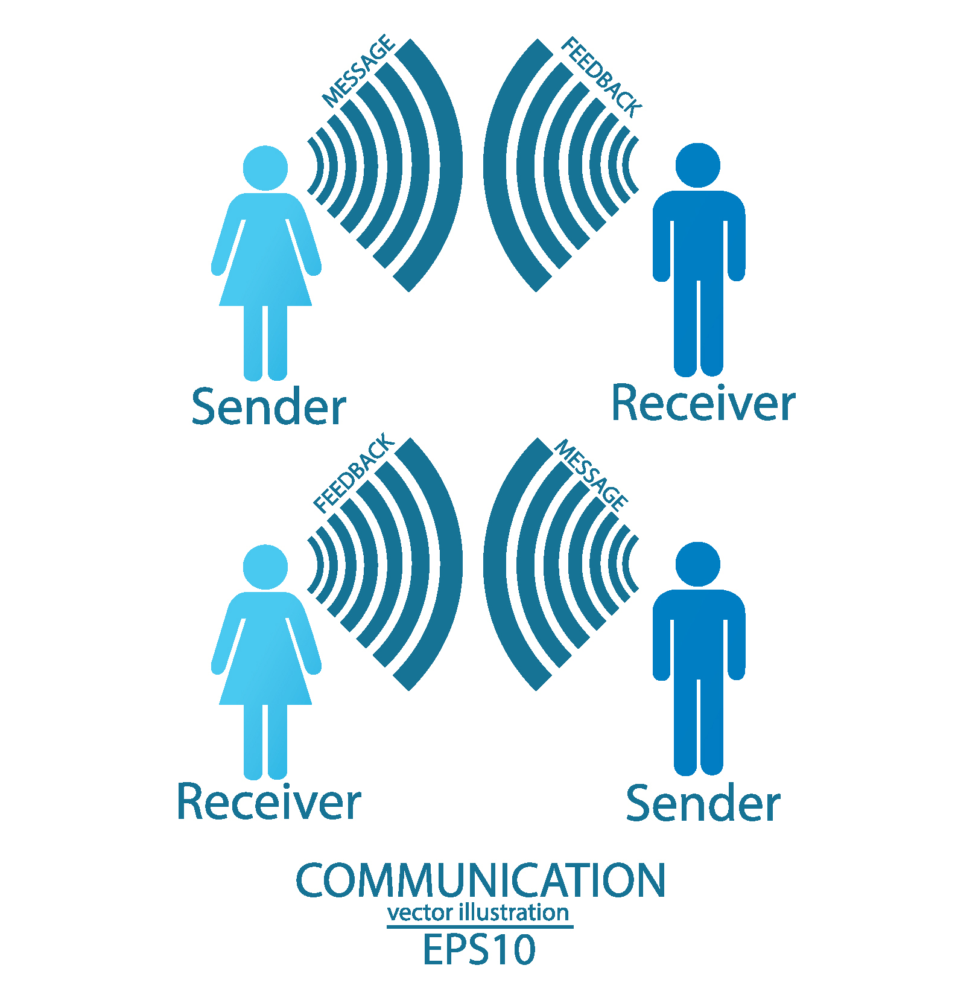
Active Listening
Notes:
Active listening reflects what a person is saying to confirm comprehension.
“What I understand you to be saying is this...” By rephrasing the information and bouncing it
back to the speaker, the listener confirms that the message has been correctly received.
Listeners doing this are not making value judgments. They are simply
● making sure they are hearing what the speakers have to say; and
● letting the speakers know that their messages are getting through.

Slide 8
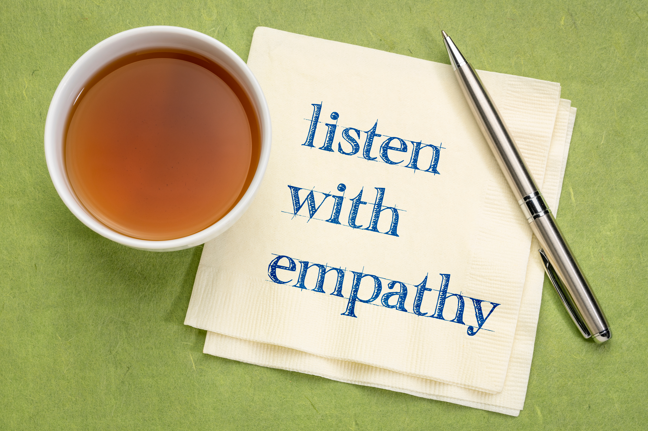

Effective Listening
Notes:
Empathetic listening is a sincere attempt by a listener to understand in depth what a speaker
is saying.
Empathetic listeners pay attention to more than just the words they hear. They also take care to
notice a speaker’s body language, tone of voice, and emotional sense and consider
them part of the complete “package”—the entire message the speaker is sending.
Empathetic listening requires you to
● put yourself in the speaker’s place;
● imagine things from the speaker’s point of view; and
● try to understand how the speaker feels. That doesn’t mean you have to agree with
everything that’s being said, but it means you at least try to understand where they’re
coming from.
To be effective, listening should be both active and empathetic. Both types are important but
employ different methods.
Role-play #2: Effective Listening

Slide 9

Role Play

Slide 10

Discussion
Monitoring our listening level
What might be a circumstance where it could be harder to listen effectively?
What can you do if someone wants to talk with you, but you recognize that something is preventing you from being an effective listener right now?

Slide 11

Feedback
A time when someone gave you negative feedback…
How did it make you feel?
How do you usually feel and react when you get negative feedback?

Slide 12
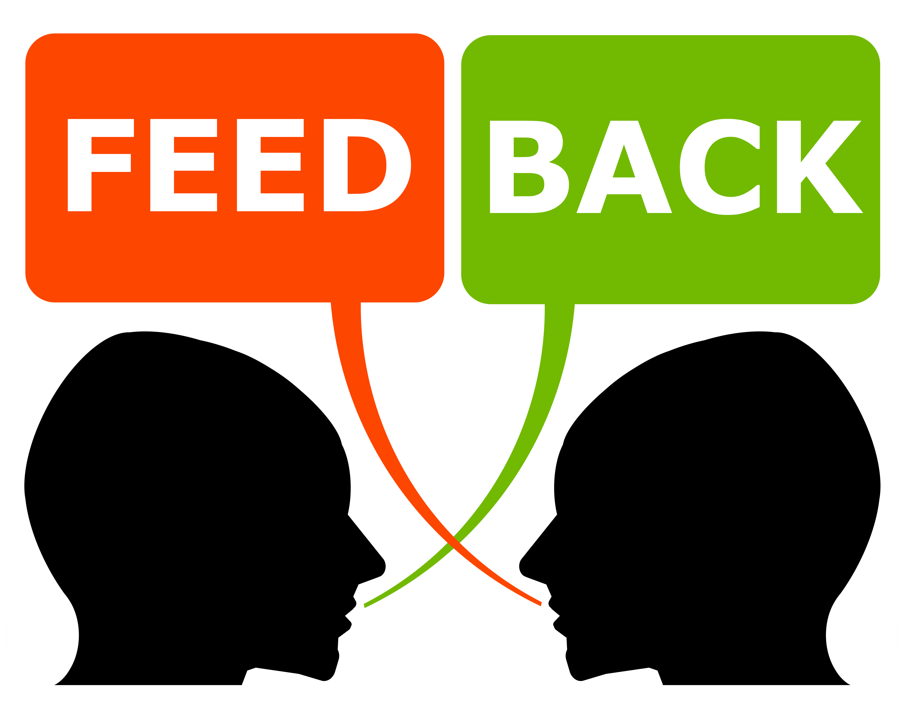
Giving & Receiving Feedback
Importance of empathy
Share ideas:
Giving feedback
Receiving feedback

Slide 13

Feedback Thoughts
A crucial skill in Scouting and the workplace
Can change a youth’s attitude and self-perception
Helps with “continual improvement”
“Growing” is a central theme of Wood Badge

Slide 14

Summary
Be aware of how we listen.
Recognize barriers to good listening.
Explain how these barriers affect listening.
Apply effective listening skills.

Slide 15

Conclusion
As leaders, we can’t be “all talk”.
We all can become more effective listeners.
Good leaders know that:
FEEDBACK IS A GIFT

Slide 16

Reflection
Your listening style
What do you do well?
What could you improve?
Wood Badge Tickets
Where will it be important to use effective listening skills?

